Slide 1

Brewing Insights: Exploring Coffee Quality
“Turning Beans into Business Intelligence”
Done By :Vrishikaa Krishna Moorthy

Slide 2

From Data to Delicious: The Journey of Coffee Quality
Raw data
Rows & Columns
Clarity from Mess
Data Cleaner
Visual Brews
This flow chart maps the journey of data as it transforms raw sensory scores into actionable insights.- From Excel
Journey has been a set of columns with more than 30 columns and 200 rows from different region of coffee .
I saw the hidden keys classification of columns and rows which belong to sub-categories which is easier for understanding them and to move towards the cleaning path .
Before Analysis we have to clear the beans by removing errors , change od data type ,null & blank values and more.- Power Query
As we see the data, I have done the report of four pages based on my idea and insights of coffee .-Power Bi Desktop
From Power bI Desktop and Published to Power Bi Service

Slide 3
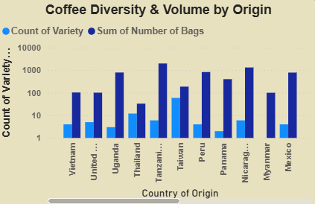
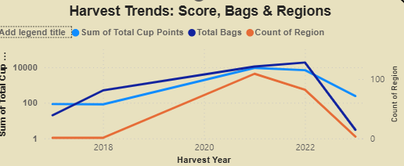
Coffee Quality Analysis - Regional & Variety Exploration
📊 Volume vs. Variety- Higher bag counts correlate with greater bean diversity - Indicates robust cultivation ecosystems
📈 Harvest & Quality Trends- Steady growth in cup scores and bag volumes - Certain regions consistently outperform in quality
🧩 Partner Distribution- 20 IN-partners contribute to sourcing - Balanced weight distribution with key contributors
🏆 Quality Hierarchy- Top countries (e.g., Ethiopia, Colombia) lead in cup points - Reinforces global premium coffee reputation
💡 Strategic Takeaways- Focus on high-performing regions - Strengthen key partnerships - Leverage diversity for innovation - Monitor trends for future planning.
🧾 Key Insights from Card Visuals-
Average Weight per Partner: 237.99 Kg → Indicates typical shipment size and sourcing scale
Total IN-Partners: 20 → Reflects a moderately distributed sourcing network
Total Countries Represented: 196 → Highlights global reach and data diversity
Most Common Variety: Caturra → Frequently cultivated bean across regions-
Dominant Bean Colors: Blue-green, Green, Brownish-green → Suggests freshness and quality indicators

Slide 4
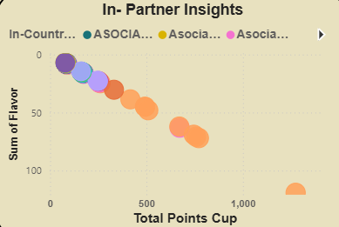
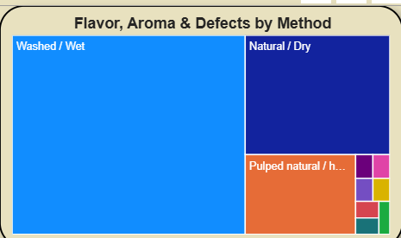
Coffee Quality Analysis - Quality & Defects Overview
🧪 Method-Based Quality Breakdown- Washed/Wet method shows highest flavor and aroma scores - Natural/Dry and Pulped Natural methods show higher defect rates
📈 Harvest Year Trends- Cup quality improved from 2014 to 2022 - Category 1 & 2 defects show fluctuating patterns across years
👥 Partner Insights- In-Country partners show strong correlation between flavor and cup score - a. SOCIA partners vary in performance, suggesting room for improvement
🌍 Country-Wise Breakdown- Countries with higher bag counts tend to have higher cup scores - Indicates consistent quality from top-producing regions🌱 Variety Filter- Dominant varieties include Bourbon, Castillo, and Caturra - Useful for targeted quality improvement and sourcing strategies
📌 Summary Metrics-
Avg Moisture: 10.69
Avg Total Cup Points: 8
Maximum Total Cup Points :89.33
We have also used slicers for dynamic visualization of the Power Bi Report based on Variety

Slide 5
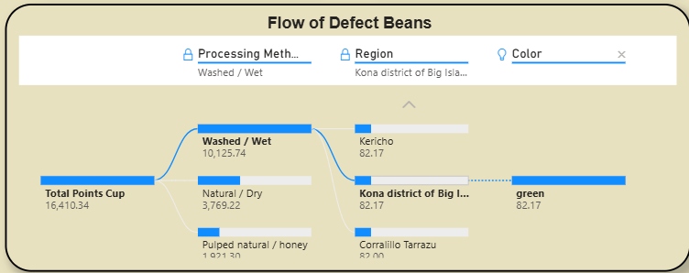
Coffee Quality Analysis - Defect & Drill Beans
📊 Defect Category Distribution- Categories: No Defects, Low, Medium, High Defects- Countries analyzed: Ethiopia, Colombia, Brazil, Vietnam, Indonesia, Honduras, Peru, Mexico, Guatemala, India
🔄 Flow of Defect Beans- Visual chart shows how defect beans move through processing stages - Useful for identifying where most defects occur and how they’re managed
📈 Quality Metrics- Max Defect Rate: 12% - Min Defect Rate: 1% - Average Defect Rate: 6.88% - Total Beans Analyzed: 1000 - Violations Detected: 125
📉 Visual Highlights- Pie Chart: Shows proportion of defect categories - Bar Chart: Compares defect rates across countries - Line Chart: Tracks defect rate trends over time---

Slide 6
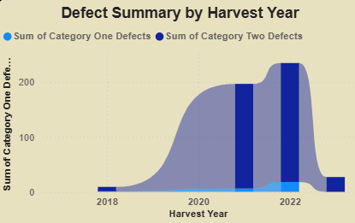
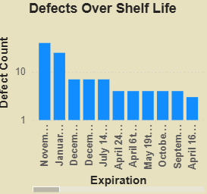
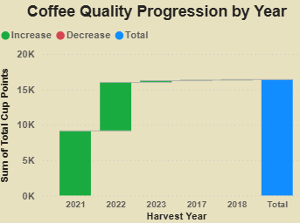
Coffee Quality Analysis - Time and Trends
📈 Visual & Sensory Defects by Grading Date- Line graph shows defect fluctuations over time- Highlights seasonal or operational patterns in quality issues.
📊 Coffee Progression by Year- Bar chart tracks annual growth or decline in coffee metrics- Useful for identifying long-term trends in production or quality.
🧪 Defects by Processing Type- Stacked bar chart compares visual vs. sensory defects- Processing methods like Washed, Natural, and Pulped show varying defect levels.
📉 Defects Over Time- Horizontal bar chart breaks down defect counts by time period- Reveals critical windows for quality control.
Strategic Takeaways- Monitor grading dates to predict defect spikes- Optimize processing methods to reduce sensory issues- Use year-wise progression to forecast future performance.

Slide 7
☕ Business Insights & Strategies
📊 Operational Insights - Average shipment weight of 237.99 Kg suggests standardized logistics across partners - 20 IN-partners indicate a moderately distributed sourcing network, allowing for focused relationship management - 196 countries represented, showcasing global sourcing potential and market diversity
🧪 Quality Control Strategy- Caturra as the dominant variety offers a benchmark for quality standardization - Bean colors like blue-green and green signal freshness—can be used as visual quality indicators - Defect tracking by grading date and processing method enables targeted interventions
📈 Trend-Based Strategy- Year-wise progression charts reveal improving cup scores, suggesting successful quality initiatives - Seasonal defect patterns help optimize harvest timing and processing schedules
👥 Partner Optimization- Performance variation among partners (e.g., a. SOCIA vs. IN-country) highlights areas for training or renegotiation - Weight and quality correlation can guide partner incentives or volume-based contracts
🌍 Market Strategy- Countries with high bag counts and high cup scores are ideal for premium product positioning - Variety filters (e.g., Bourbon, Castillo) support targeted marketing and regional branding

Slide 8

Thank you
Contact us at:
Vrishikaa Krishna Moorthy
Vrishikaa03gmail.com

